Slide 1
No | Status | Remark
1 |  | Basic knowledge of FET
2 |  | Basic knowledge of package
 |  | Common failure
 |  | fab process of Cowos
 |  | proc
common techniques, real-world use cases, challenges, and future directions
any real-world use Failure analysis cases with below key words.
- Curve Tracer, Focused Ion Beam (FIB), Scanning Electron Microscope (SEM))
- Utilize scan diagnosis, Automatic Test Pattern Generation (ATPG)), and memory Built-In Self-Test (BIST) tools for fault isolation.
- Fin Field-Effect Transistor/Gate-All-Around Field-Effect Transistor (FinFET/GAA)
- Emission Microscope (EMMI) and Optical Beam Induced Resistance Change (OBIRCH)

Slide 2
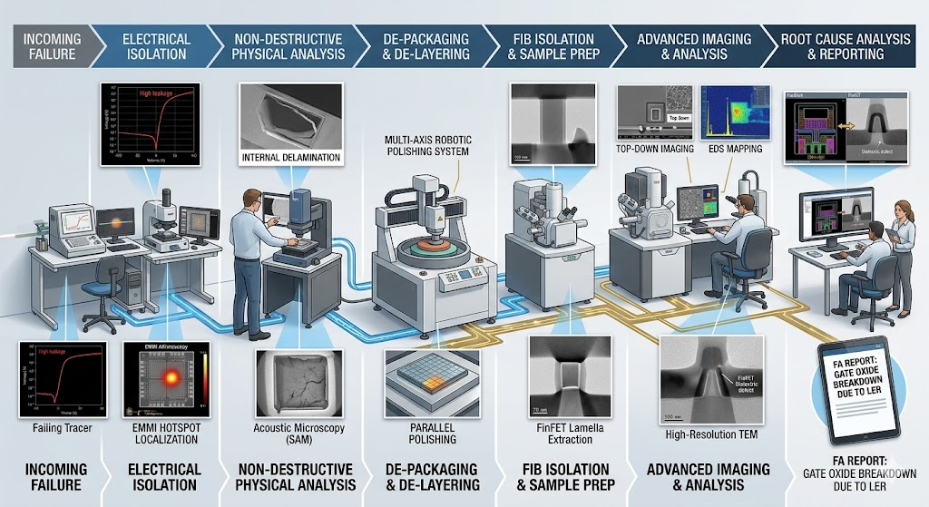
The Workflow: A Seven-Stage Journey
This comprehensive image details how an abstract, incoming failure (left) is systematically isolated, exposed, imaged, and chemically analyzed, concluding with a final forensic report (right). Each major phase features the dedicated professional instrumentation required.
Stage 1: Incoming Failure (The "Crime Scene")
The workflow begins with a packaged chip that has failed initial testing. This stage sets up the problem: a non-functional device. We categorize the symptom.
Stage 2: Electrical Isolation (Finding the Culprit)
Before cutting, we must know where to look. As shown, we use a manual prober or automatic test equipment (ATE) to measure Curve Tracing ($I-V$). An insect shows the telltale signature of a failing tracer (high leakage current). We then use a system like EMMI (Emission Microscopy) or thermal laser stimulation to identify the exact spatial coordinate of the fault, visualized as an EMMI hotspot.
Stage 3: Non-Destructive Physical Analysis (Checking the Container)
Often overlooked, we must check the structural integrity of the entire package before proceeding. As illustrated, Acoustic Microscopy (SAM) or 2D/3D X-ray allows us to inspect internal packaging defects, such as the internal delamination between the silicon die and the mold compound visible in the SAM inset.
Stage 4: De-Packaging & De-Layering (Manual Surgery)
Now, we must physically access the silicon die. As shown, we may use chemical decapsulation (not pictured) and then transition to Parallel Polishing. A precision tool like the multi-axis robotic polisher shown can strip away dozens of metal interconnect layers, flattening the sample until we stop precisely at a target metal level.
Stage 5: FIB Isolation & Sample Prep (Nano-Surgery)
This is the most critical extraction step. Once the failure area is narrowed down to a single transistor, a Dual-Beam FIB (Focused Ion Beam) system is used. The FIB cuts a microscopic cross-section. An inset reveals the high-precision FinFET Lamella Extraction, taking a slice less than 30nm thick from a 3D fin structure.
Stage 6: Advanced Imaging & Analysis (The Verdict)
This is where sub-nanometer vision is achieved. The workflow highlights two essential tools:
Scanning Electron Microscopy (SEM) / EDS: A lab scientist uses the SEM for detailed top-down imaging of metal lines. Simultaneously, an inset shows EDS (Energy-Dispersive X-ray Spectroscopy) Mapping, providing a color-coded map of elemental composition to identify contaminants.
High-Resolution TEM: The FIB lamella is transferred to the TEM (Transmission Electron Microscope). As shown in the inset, the TEM is the only tool capable of providing atomic-resolution cross-sections. The final image clearly identifies the root cause: a FinFET gate dielectric defect.
Stage 7: Root Cause Analysis & Reporting (The Case is Closed)
Finally, the engineering team reviews all isolated data (layout, EMMI data, SEM images, and TEM cross-sections). They connect the final physical defect (the TEM breakdown) back to the original electrical symptom. The outcome is a definitive forensic report, visualized on the final tablet: "FA REPORT: GATE OXIDE BREAKDOWN DUE TO LER (Line Edge Roughness)."
FA workflow

Slide 3

Basic knowledge of FET - understand P/N
n channel : G=+ve, current flow
P channel :
n channel :

Slide 4
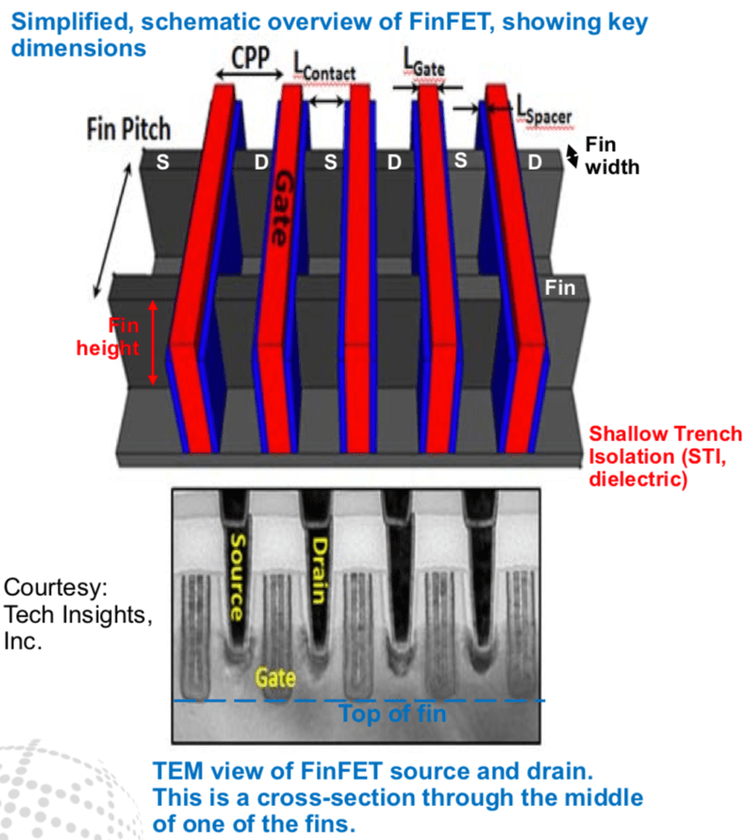
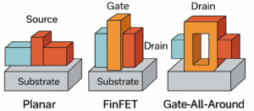
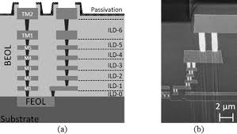
Basic knowledge of FET

